Slide 1


Azərbaycan Dövlət Neft və Sənaye Universiteti
Calculus
Single Variable

Slide 2
Applications of Integration:
The Shell Method

Slide 3
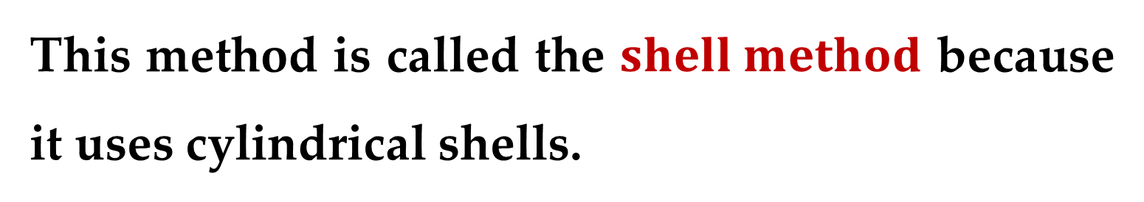
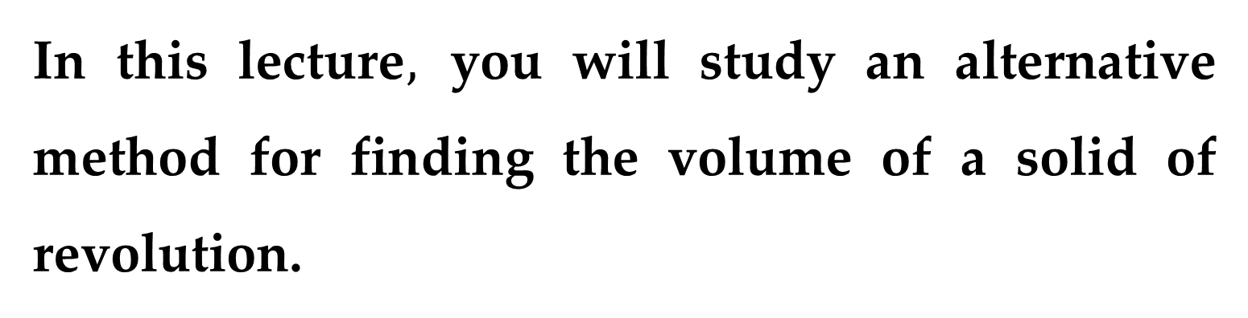
In this lecture$,$ you will study an alternative method for finding the volume of a solid of revolution.
This method is called the $shell method$ because it uses cylindrical shells.
A comparison of the advantages of the disk and shell methods is given later in this lecture.

Slide 4
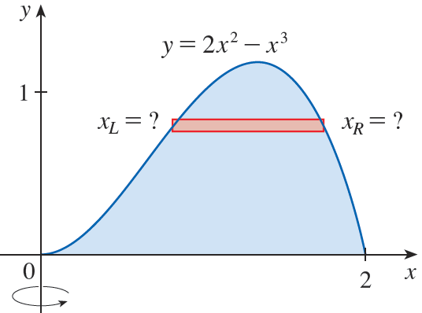
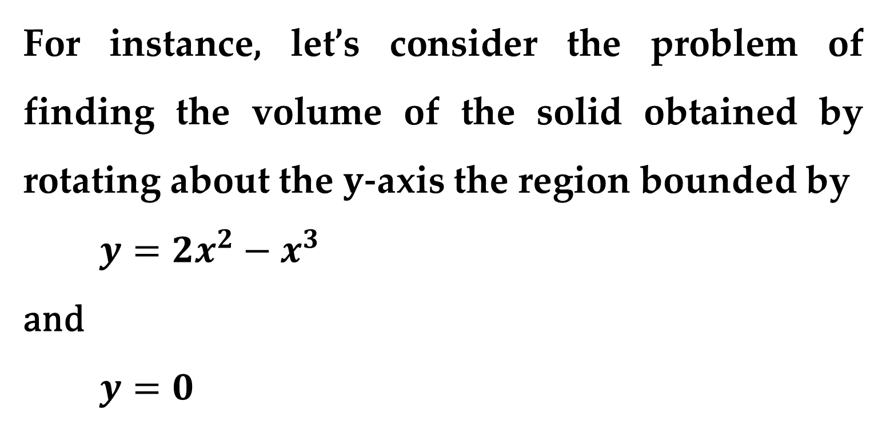
Some volume problems are very difficult to handle by the disk and washer methods.
For instance, let’s consider the problem of finding the volume of the solid obtained by rotating about the $y$-axis the region bounded by
$y=2x^{2}−x^{3}$
and
$y=0$

Slide 5
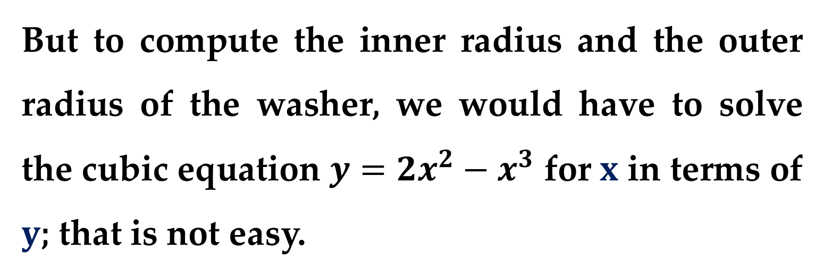
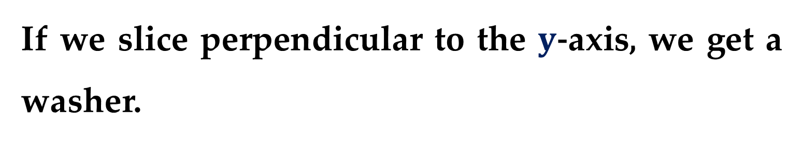
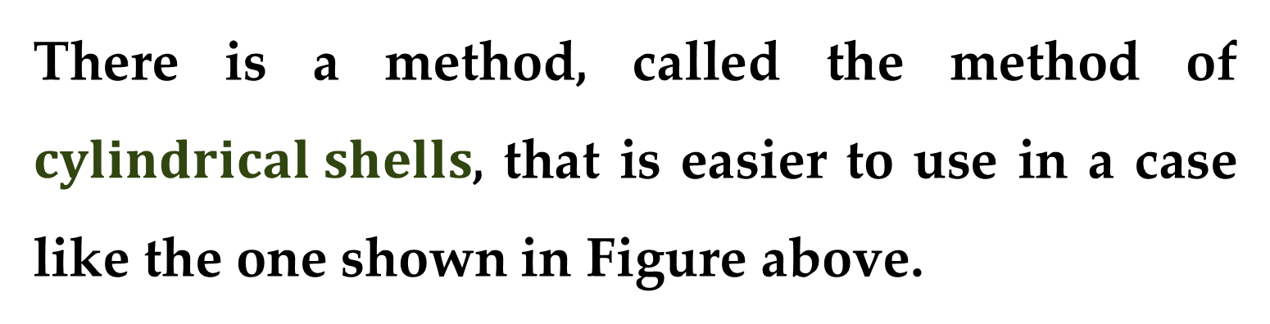
If we slice perpendicular to the $y$-axis, we get a washer.
But to compute the inner radius and the outer radius of the washer, we would have to solve the cubic equation $y=2x^{2}−x^{3}$ for $x$ in terms of $y$; that is not easy.
There is a method, called the method of $cylindrical shells$, that is easier to use in a case like the one shown in Figure above.

Slide 6
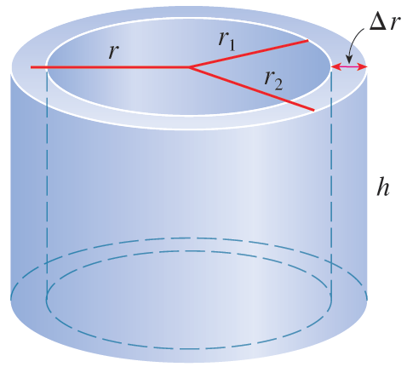
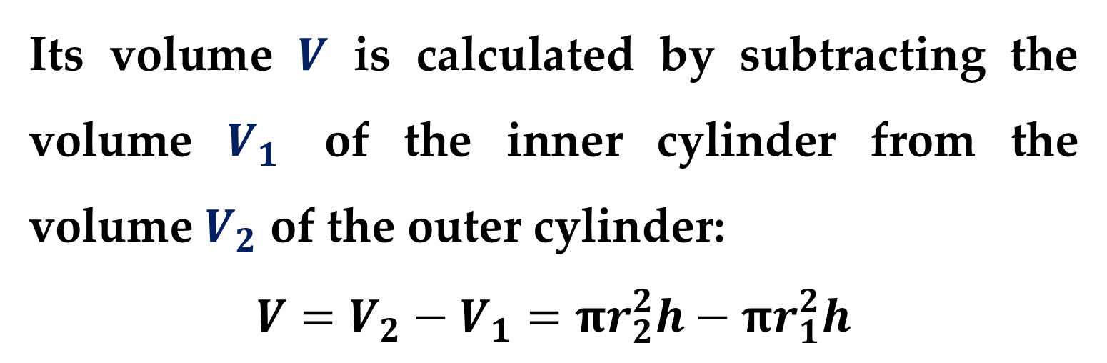
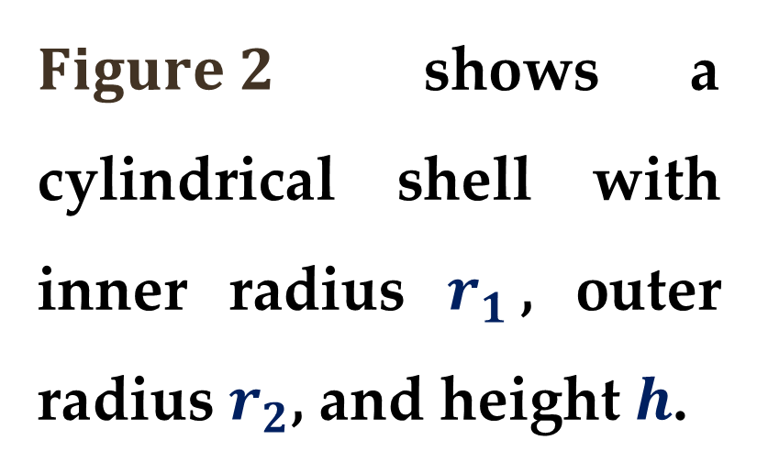
$Figure 2$ shows a cylindrical shell with inner radius $r_{1}$, outer radius $r_{2}$, and height $h$.
Its volume $V$ is calculated by subtracting the volume $V_{1}$ of the inner cylinder from the volume $V_{2}$ of the outer cylinder:
$$V=V_{2}−V_{1}=πr_{2}^{2}h−πr_{1}^{2}h$$

Slide 7
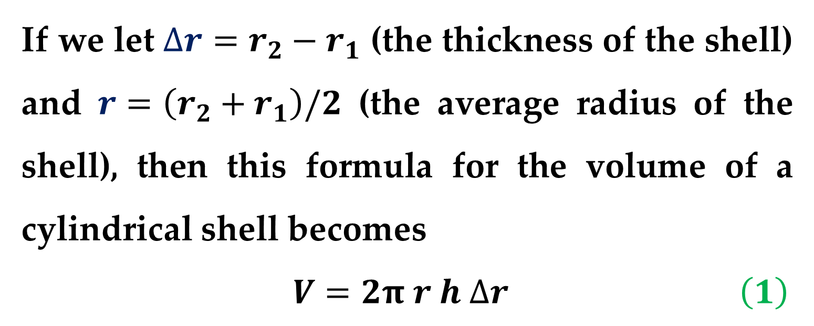
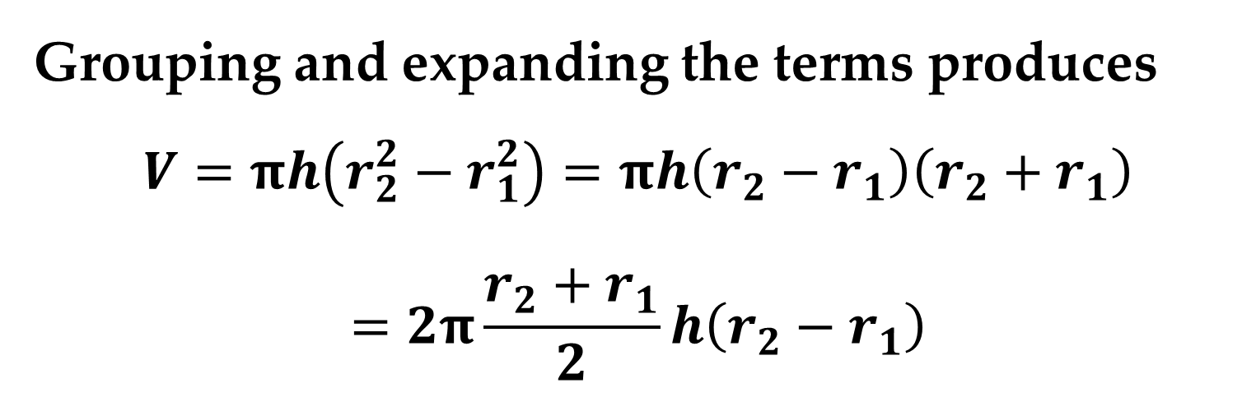
Grouping and expanding the terms produces
$$V=πh\left(r_{2}^{2}−r_{1}^{2}\right)=πh\left(r_{2}−r_{1}\right)\left(r_{2}+r_{1}\right)$$
$$=2π\frac{r_{2}+r_{1}}{2}h\left(r_{2}−r_{1}\right)$$
If we let $∆r=r_{2}−r_{1}$ (the thickness of the shell) and $r=\left(r_{2}+r_{1}\right)/2$ (the average radius of the shell), then this formula for the volume of a cylindrical shell becomes
$V=2π r h ∆r$ $\left(1\right)$

Slide 8
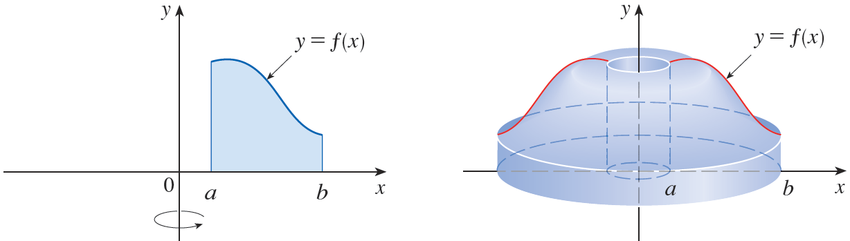
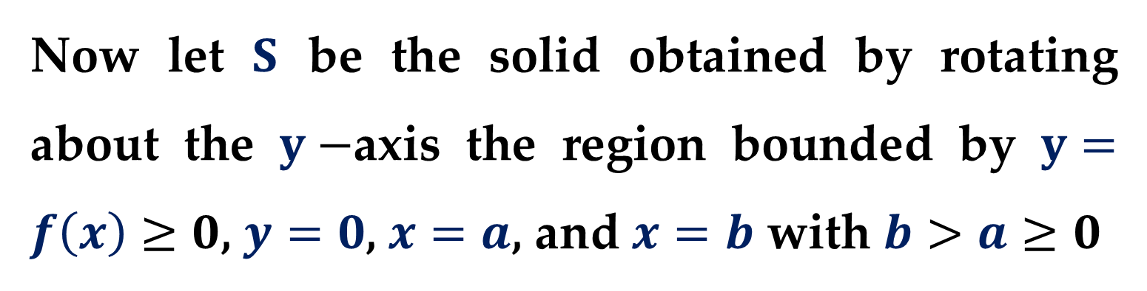
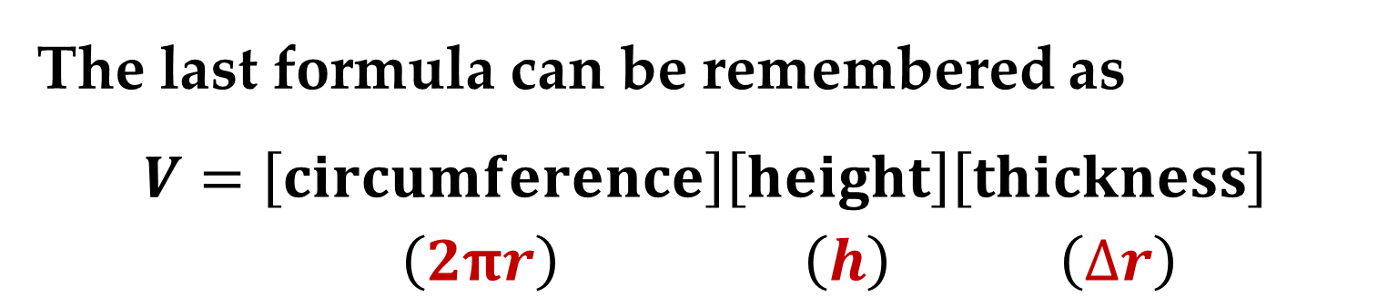
The last formula can be remembered as
$$V=\left[circumference\right]\left[height\right]\left[thickness\right]$$
$\left(2πr\right)$ $\left(h\right)$ $\left(∆r\right)$
Now let $S$ be the solid obtained by rotating about the $y−$axis the region bounded by $y=f\left(x\right)≥0$, $y=0$, $x=a$, and $x=b$ with $b>a≥0$

Slide 9
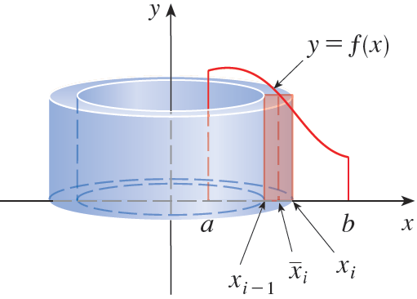
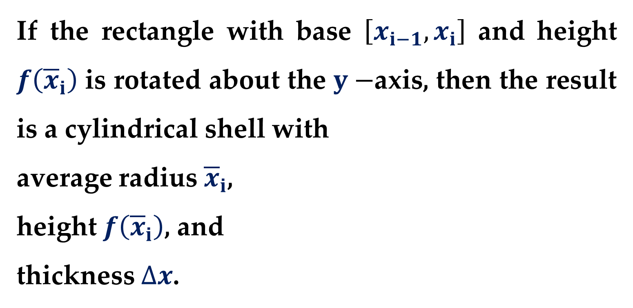
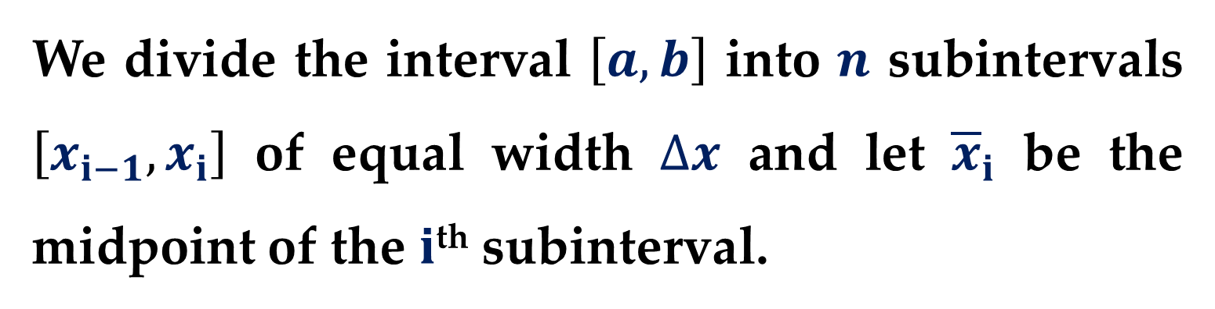
We divide the interval $\left[a,b\right]$ into $n$ subintervals $\left[x_{i−1},x_{i}\right]$ of equal width $∆x$ and let ${\overline{x}}_{i}$ be the midpoint of the $i$^{th} subinterval.
If the rectangle with base $\left[x_{i−1},x_{i}\right]$ and height $f\left({\overline{x}}_{i}\right)$ is rotated about the $y−$axis, then the result is a cylindrical shell with
average radius ${\overline{x}}_{i}$,
height $f\left({\overline{x}}_{i}\right)$, and
thickness $∆x$.

Slide 10
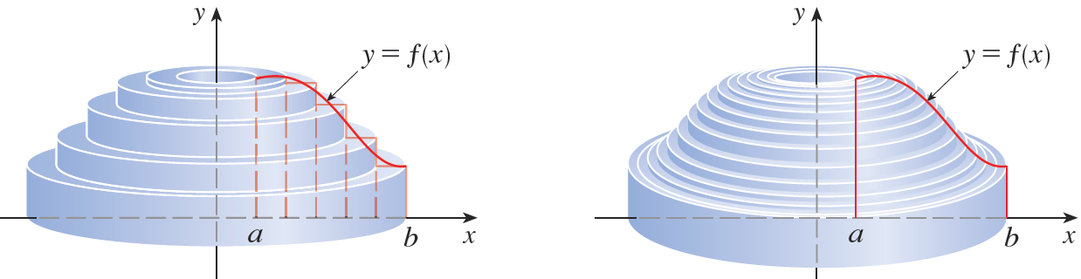
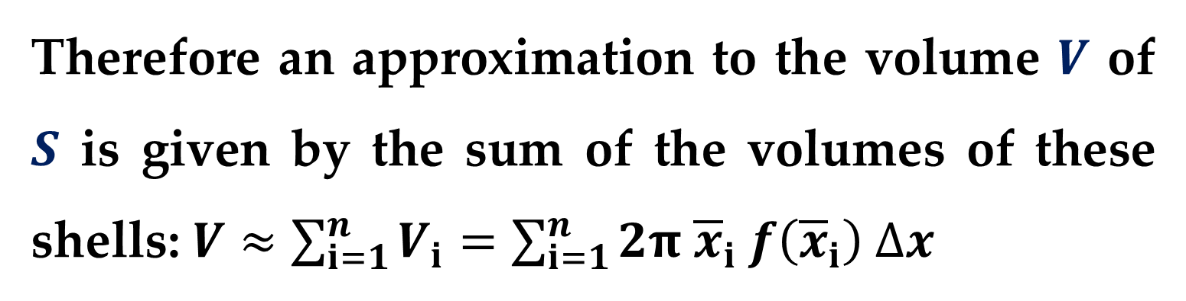

So by $Formula \left(1\right)$ its volume is
$$V_{i}=\left(2π {\overline{x}}_{i}\right) f\left({\overline{x}}_{i}\right) ∆x$$
Therefore an approximation to the volume $V$ of $S$ is given by the sum of the volumes of these shells: $V≈\sum_{i=1}^{n}{V_{i}}=\sum_{i=1}^{n}{2π {\overline{x}}_{i} f\left({\overline{x}}_{i}\right) ∆x}$

Slide 11
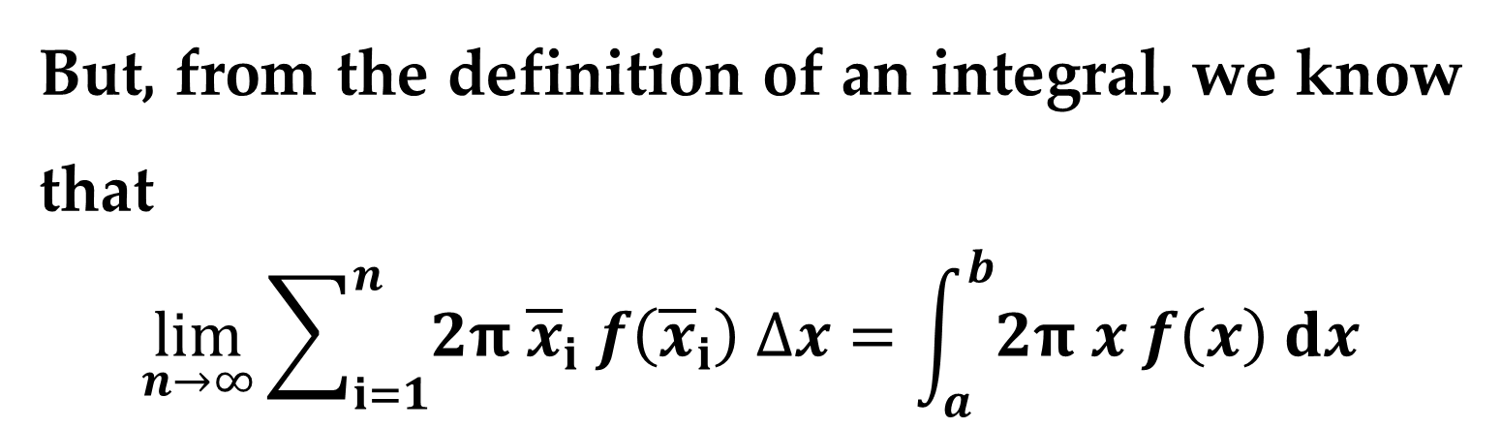
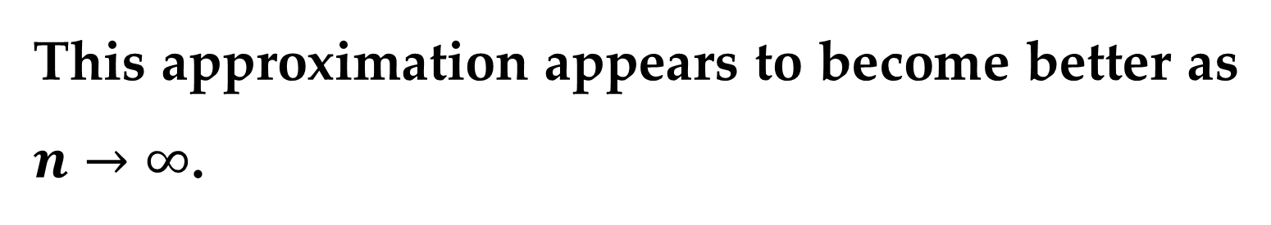
This approximation appears to become better as $n→∞$.
But, from the definition of an integral, we know that
$$\lim_{n→∞}{\sum_{i=1}^{n}{2π {\overline{x}}_{i} f\left({\overline{x}}_{i}\right) ∆x}}=\int_{a}^{b}{2π x f\left(x\right) dx}$$
Thus the following two formulas appear plausible for evaluating volumes of solids of revolution.

Slide 12
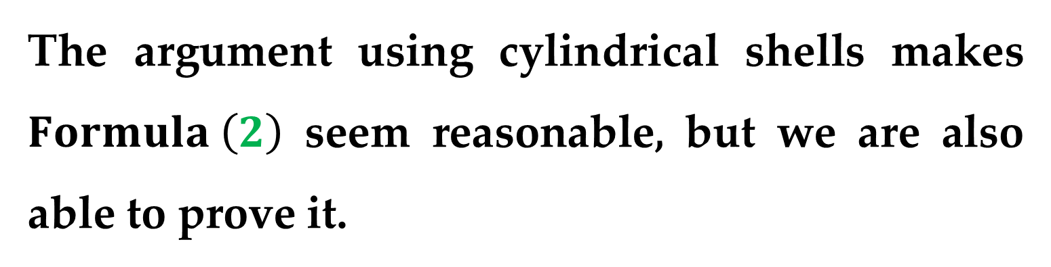
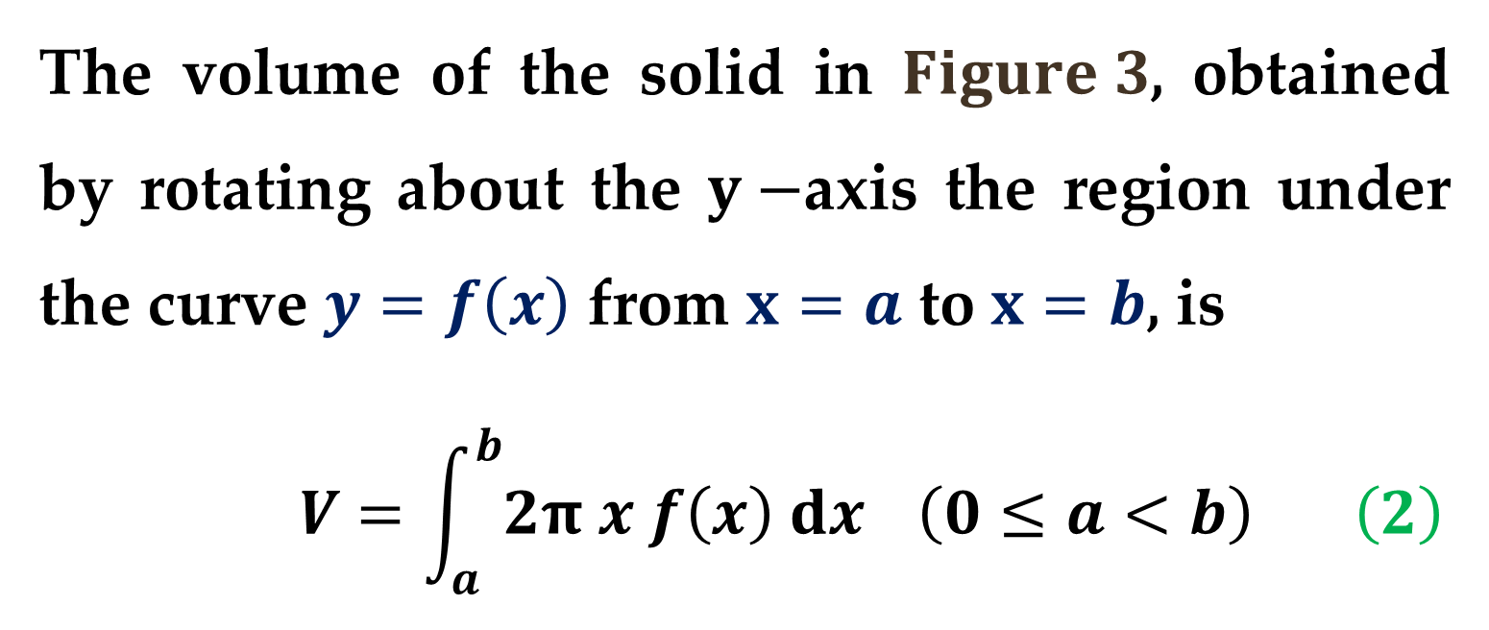
The volume of the solid in $Figure 3$, obtained by rotating about the $y−$axis the region under the curve $y=f\left(x\right)$ from $x=a$ to $x=b$, is
$$V=\int_{a}^{b}{2π x f\left(x\right) dx} \left(0≤a<b\right) \left(2\right)$$
The argument using cylindrical shells makes $Formula \left(2\right)$ seem reasonable, but we are also able to prove it.

Slide 13
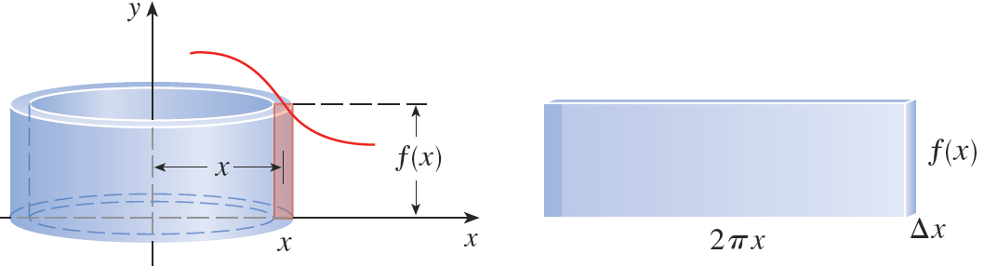
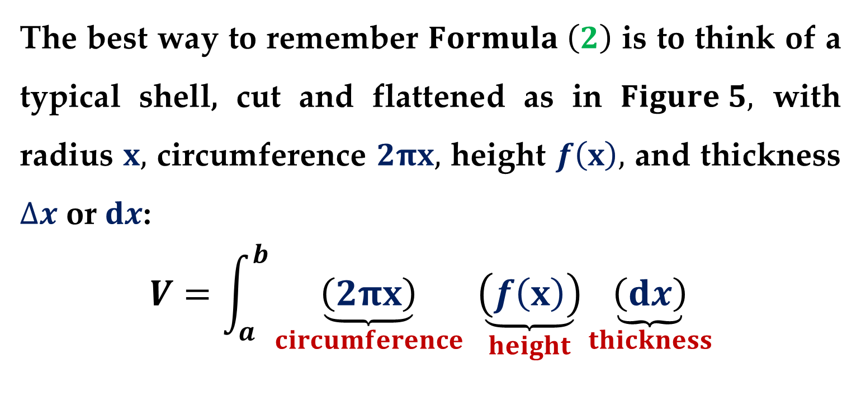
The best way to remember $Formula \left(2\right)$ is to think of a typical shell, cut and flattened as in $Figure 5,$ with radius $x,$ circumference $2πx,$ height $f\left(x\right),$ and thickness $∆x$ or $dx$:
$$V=\int_{a}^{b}{\underset{circumference}{\underbrace{\left(2πx\right)}} \underset{height}{\underbrace{\left(f\left(x\right)\right)}}\underset{thickness}{\underbrace{\left(dx\right)}}}$$

Slide 14
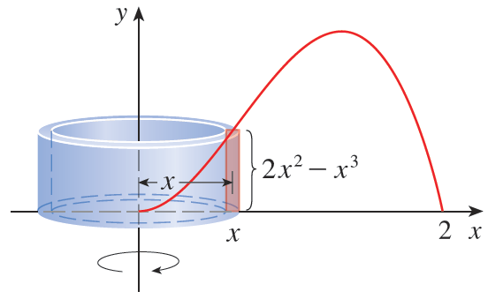
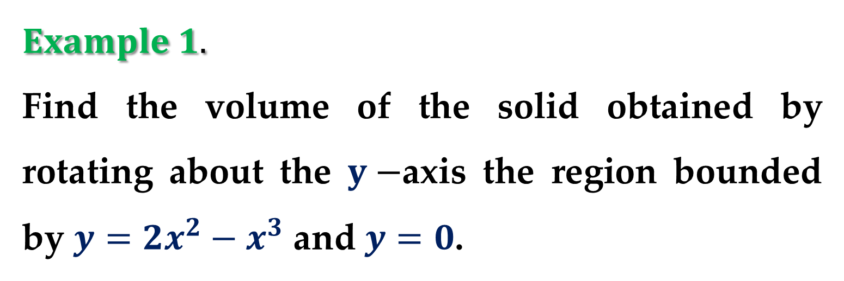
$$Example 1.$$
Find the volume of the solid obtained by rotating about the $y−$axis the region bounded by $y=2x^{2}−x^{3}$ and $y=0$.

Slide 15
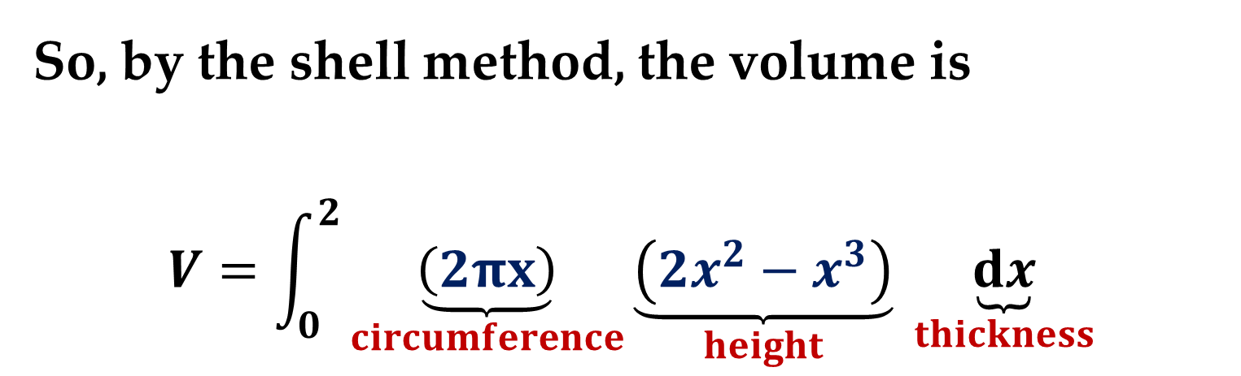
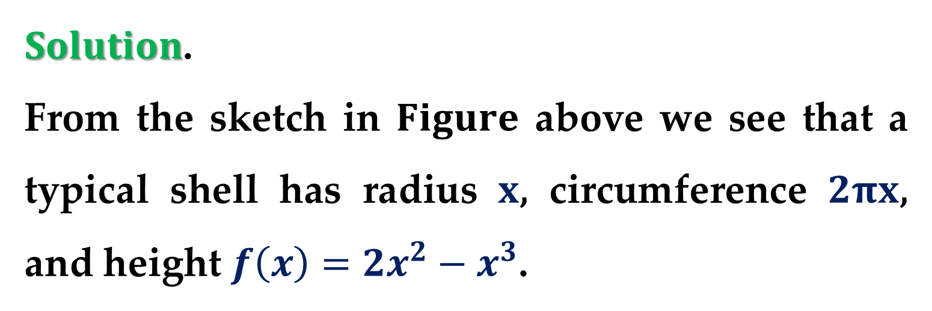
$Solution$.
From the sketch in $Figure$ above we see that a typical shell has radius $x$, circumference $2πx$, and height $f\left(x\right)=2x^{2}−x^{3}$.
So, by the shell method, the volume is
$$V=\int_{0}^{2}{\underset{circumference}{\underbrace{\left(2πx\right)}}\underset{height}{\underbrace{\left(2x^{2}−x^{3}\right)}} \underset{thickness}{\underbrace{dx}}}$$

Slide 16
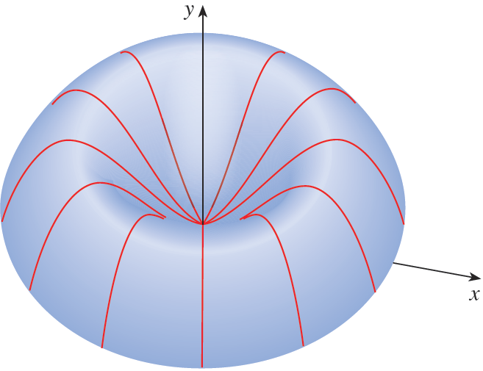
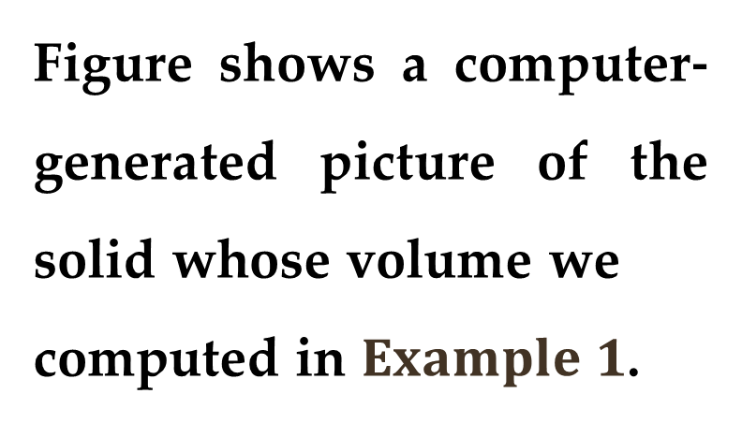
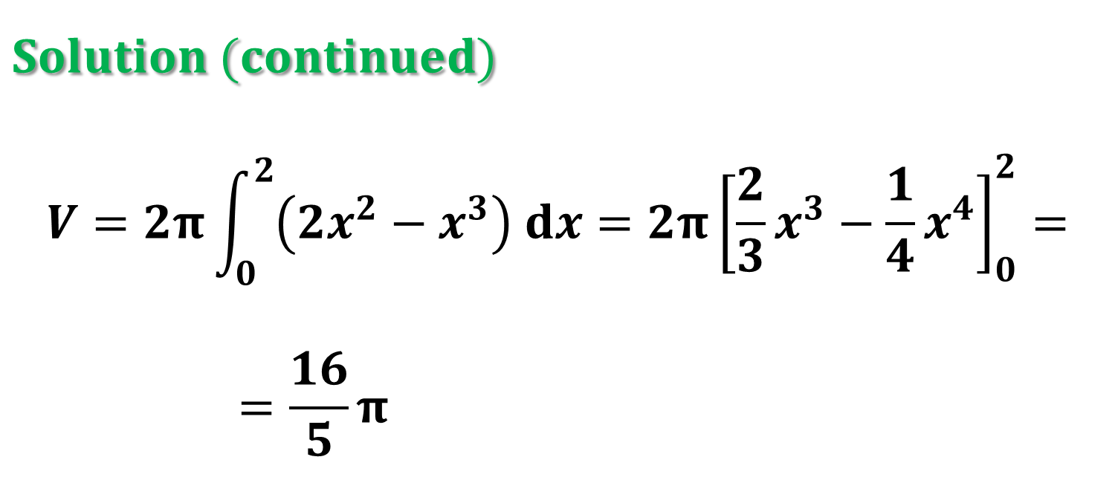
$$Solution (continued)$$
$$V=2π\int_{0}^{2}{\left(2x^{2}−x^{3}\right) dx}=2π{\left[\frac{2}{3}x^{3}−\frac{1}{4}x^{4}\right]}_{0}^{2}=$$
$$=\frac{16}{5}π$$
Figure shows a computer-generated picture of the solid whose volume we
computed in $Example 1$.

Slide 17
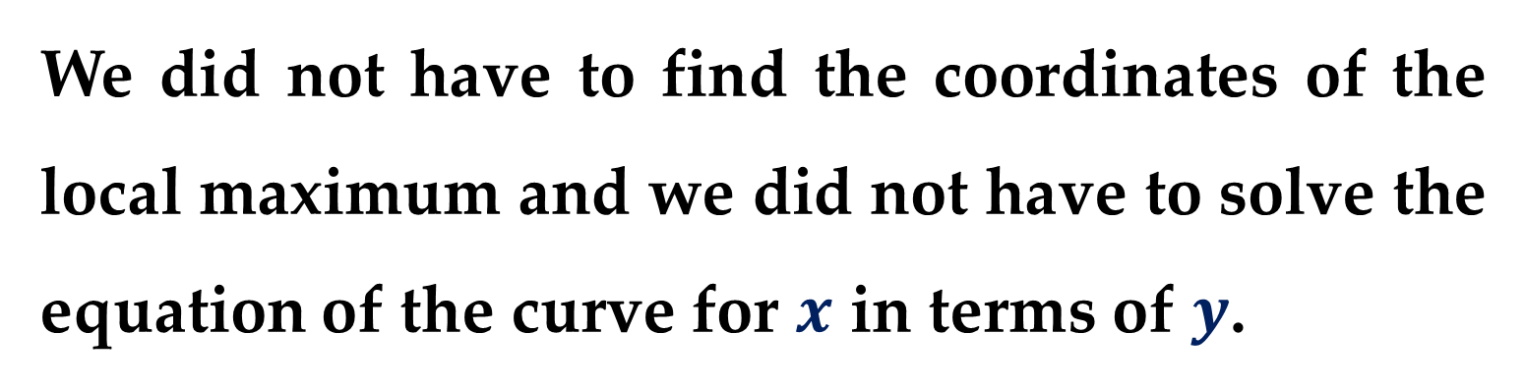
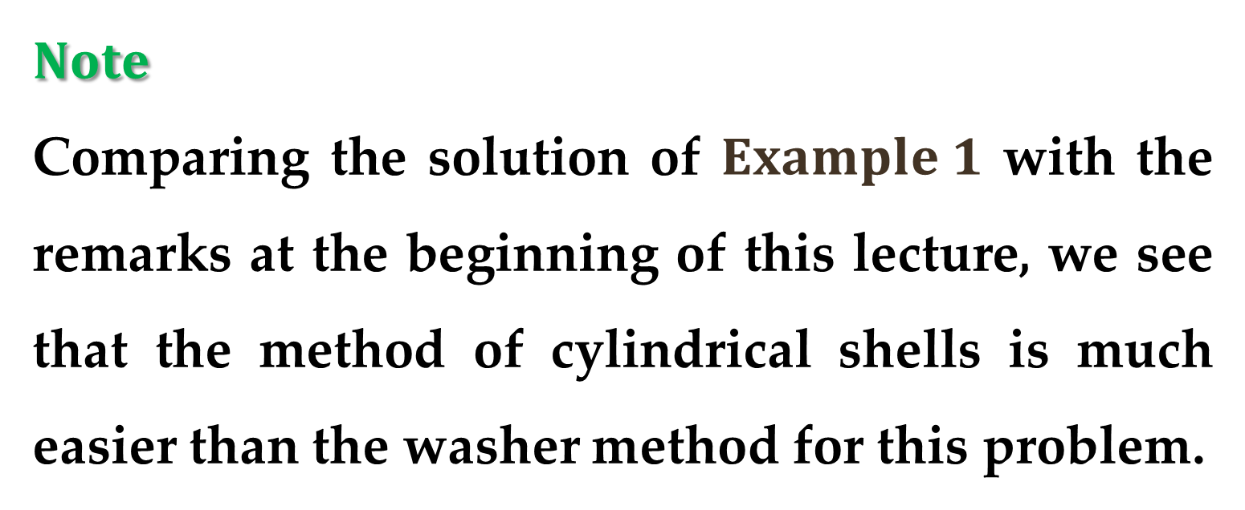
$$Note$$
Comparing the solution of $Example 1$ with the remarks at the beginning of this lecture, we see that the method of cylindrical shells is much easier than the washer method for this problem.
We did not have to find the coordinates of the local maximum and we did not have to solve the equation of the curve for $x$ in terms of $y$.

Slide 18
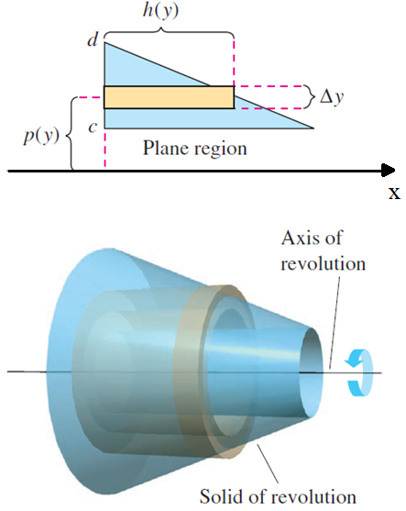
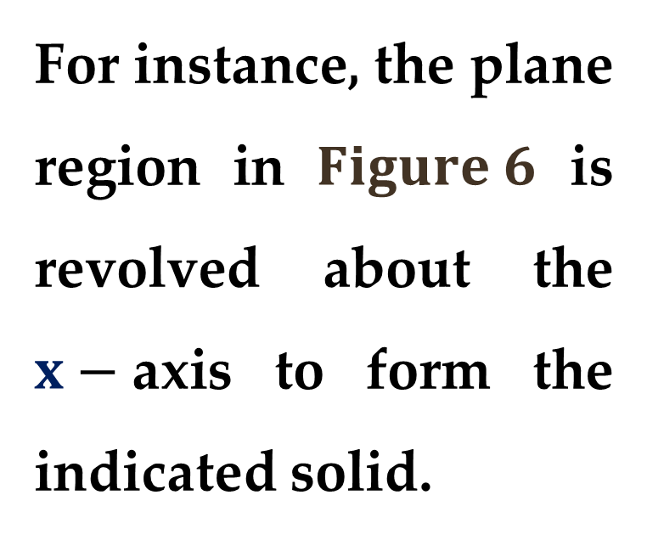
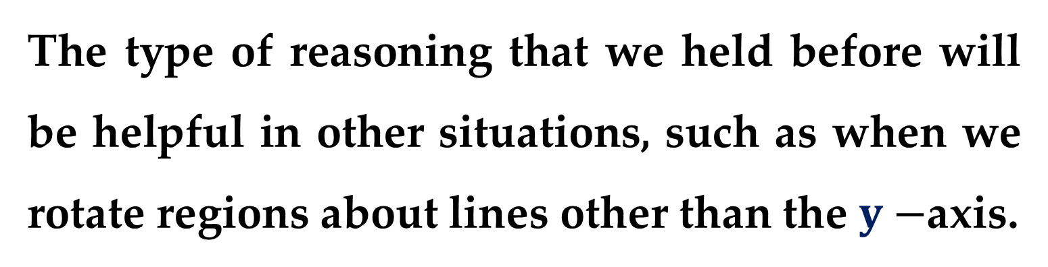
The type of reasoning that we held before will be helpful in other situations, such as when we rotate regions about lines other than the $y−$axis.
For instance, the plane region in $Figure 6$ is revolved about the $x−$axis to form the indicated solid.

Slide 19
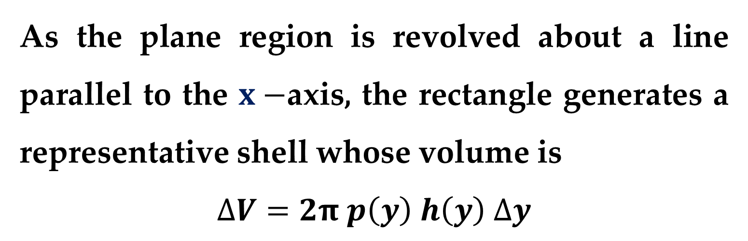
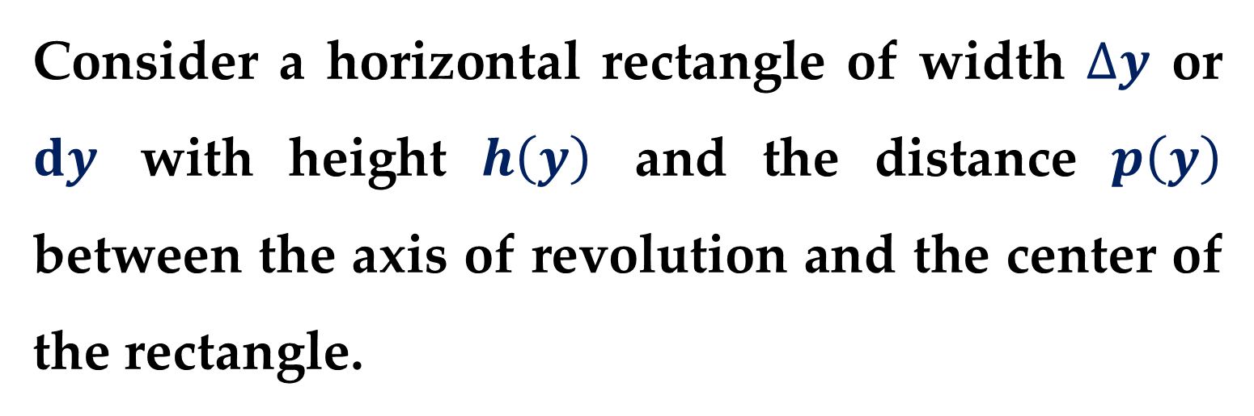
Consider a horizontal rectangle of width $∆y$ or $dy$ with height $h\left(y\right)$ and the distance $p\left(y\right)$ between the axis of revolution and the center of the rectangle.
As the plane region is revolved about a line parallel to the $x−$axis, the rectangle generates a representative shell whose volume is
$$∆V=2π p\left(y\right) h\left(y\right) ∆y$$

Slide 20
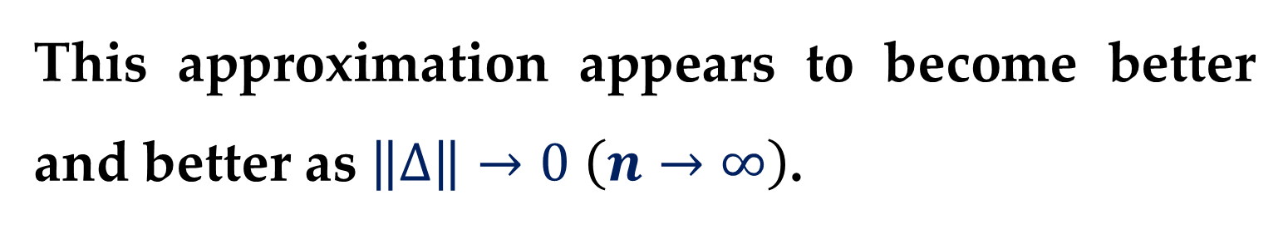
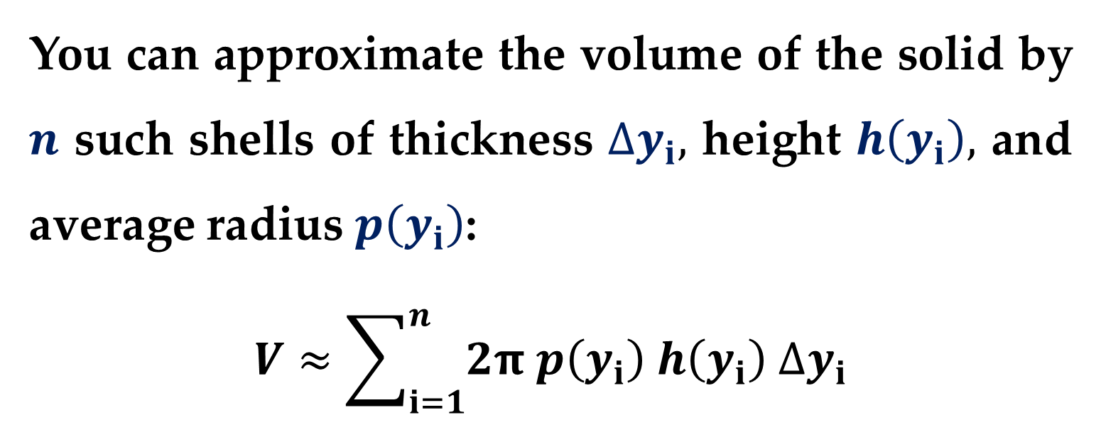
You can approximate the volume of the solid by $n$ such shells of thickness $∆y_{i},$ height $h\left(y_{i}\right),$ and average radius $p\left(y_{i}\right)$:
$$V≈\sum_{i=1}^{n}{2π p\left(y_{i}\right) h\left(y_{i}\right) ∆y_{i}}$$
This approximation appears to become better and better as $\left\|∆\right\|→0$ $\left(n→∞\right)$.

Slide 21
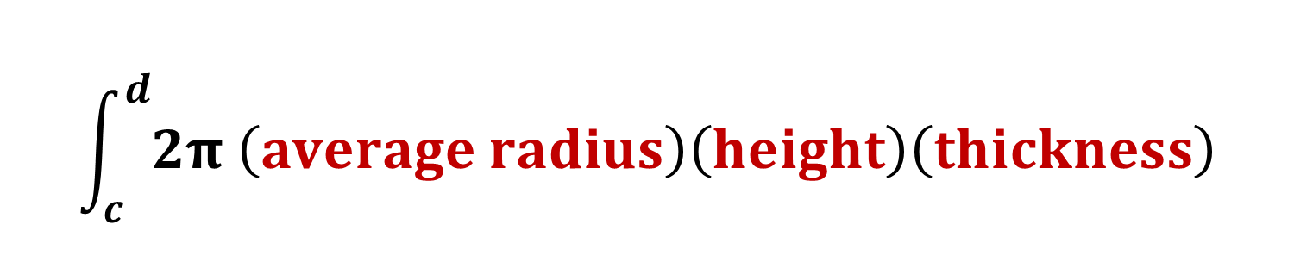
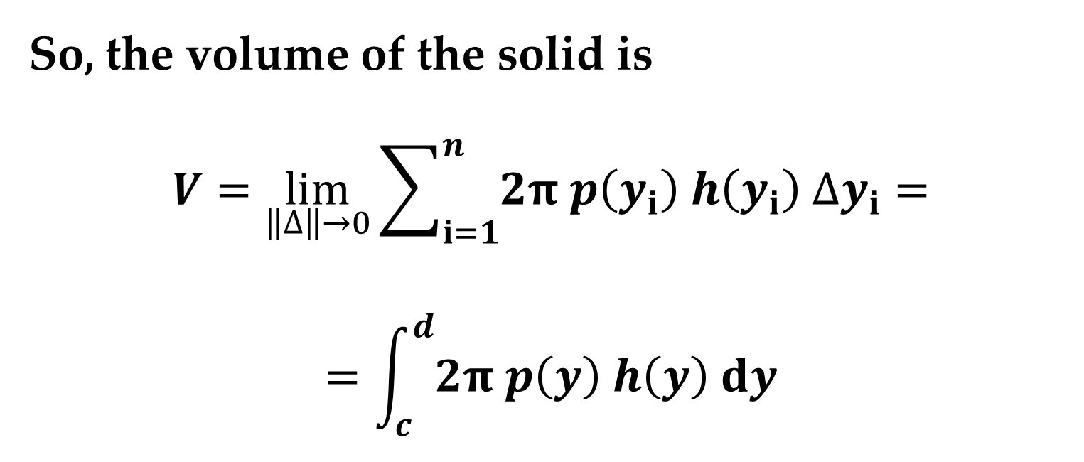
So, the volume of the solid is
$$V=\lim_{\left\|∆\right\|→0}{\sum_{i=1}^{n}{2π p\left(y_{i}\right) h\left(y_{i}\right) ∆y_{i}}}=$$
$$=\int_{c}^{d}{2π p\left(y\right) h\left(y\right) dy}$$
$$\int_{c}^{d}{2π \left(average radius\right)\left(height\right)\left(thickness\right)}$$

Slide 22
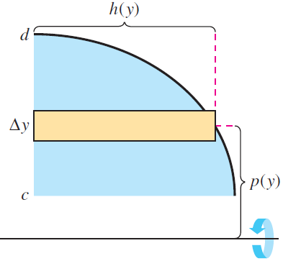
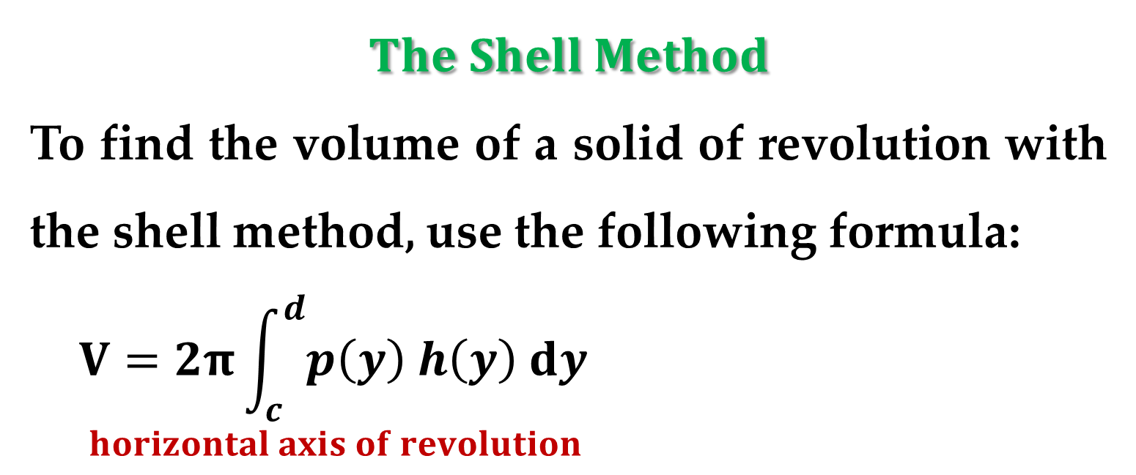
$$The Shell Method$$
To find the volume of a solid of revolution with the shell method, use the following formula:
$$V=2π\int_{c}^{d}{p\left(y\right) h\left(y\right) dy}$$
$$horizontal axis of revolution$$

Slide 23
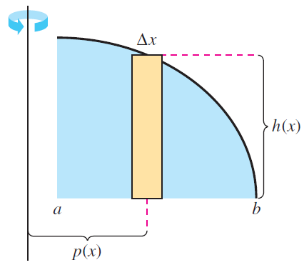
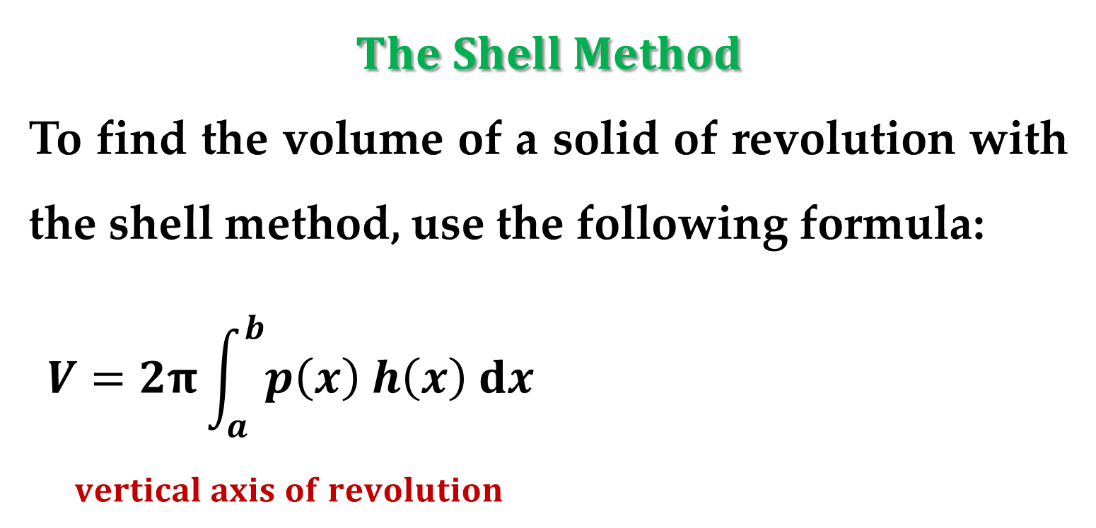
$$The Shell Method$$
To find the volume of a solid of revolution with the shell method, use the following formula:
$$V=2π\int_{a}^{b}{p\left(x\right) h\left(x\right) dx}$$
$$vertical axis of revolution$$

Slide 24
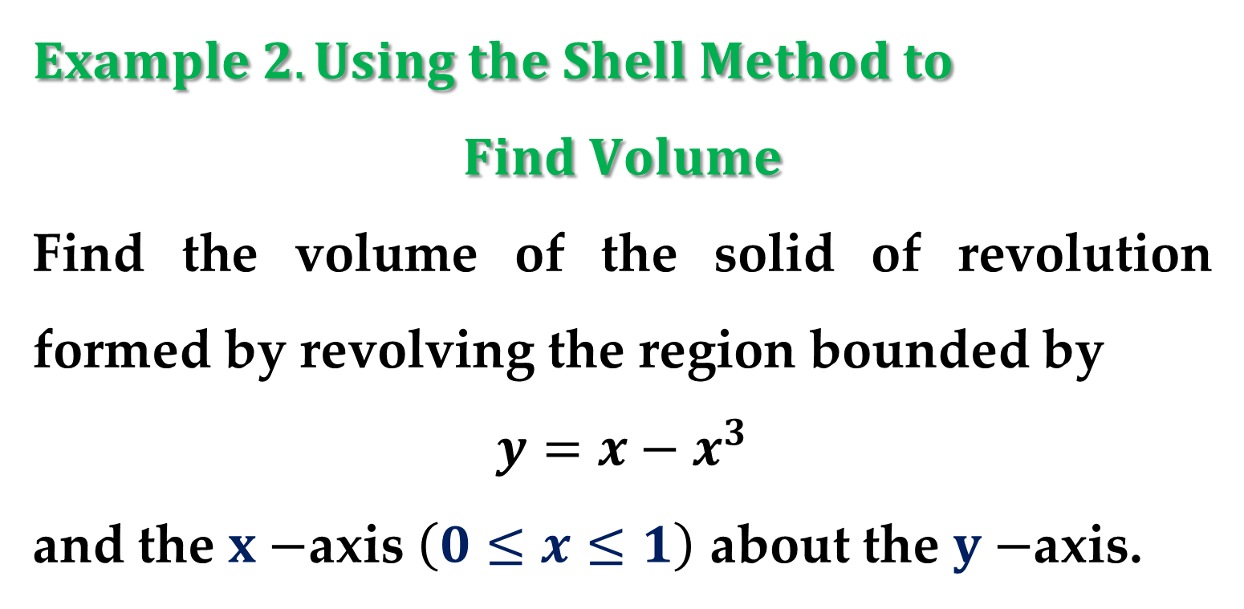
$$Example 2. Using the Shell Method to$$
$$Find Volume$$
Find the volume of the solid of revolution formed by revolving the region bounded by
$$y=x−x^{3}$$
and the $x−$axis $\left(0≤x≤1\right)$ about the $y−$axis.

Slide 25
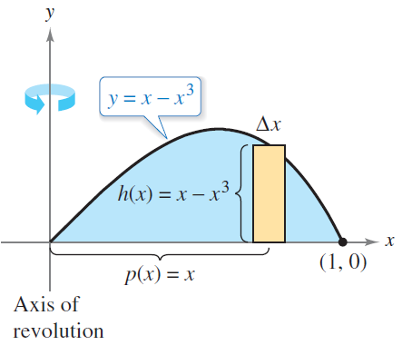


$$Solution$$
Because the axis of revolution is vertical, use a vertical representative rectangle, as shown in $Figure$.
The width $∆x$ indicates that $x$ is the variable of integration.

Slide 26


$$Solution$$
The distance from the center of the rectangle to the axis of revolution is $p\left(x\right)=x$, and the height of the rectangle is $h\left(x\right)=x−x^{3}$.
Because $x$ ranges from $0$ to $1,$ apply the shell method to find the volume of the solid:
$$V=2π\int_{a}^{b}{p\left(x\right) h\left(x\right) dx}=2π\int_{0}^{1}{\left[x\left(x−x^{3}\right)\right] dx}$$

Slide 27

$$Solution$$
$$2π\int_{0}^{1}{\left[x\left(x−x^{3}\right)\right] dx}=$$
$$2π\int_{0}^{1}{\left(x^{2}−x^{4}\right)dx}=$$
$$=2π {\left.\left(\frac{x^{3}}{3}−\frac{x^{4}}{4}\right)\right|}_{0}^{1}=2π\left(\frac{1}{3}−\frac{1}{4}\right)=2π\frac{1}{12}=\frac{π}{6}$$

Slide 28

$$Example 3. Using the Shell Method to$$
$$Find Volume$$
Find the volume of the solid of revolution formed by revolving the region bounded by the graph of
$$x=e^{−y^{2}}$$
and the $y−$axis $\left(0≤y≤1\right)$ about the $x−$axis.

Slide 29



$$Solution$$
Because the axis of revolution is horizontal, use a horizontal representative rectangle, as shown in $Figure$.
The width $∆y$ indicates that $y$ is the variable of integration.

Slide 30


$$Solution$$
The distance from the center of the rectangle to the axis of revolution is $p\left(y\right)=y,$ and the height of the rectangle is $h\left(y\right)=e^{−y^{2}}$.
Because $y$ ranges from $0$ to $1,$ the volume of the solid is
$$V=2π\int_{c}^{d}{p\left(y\right) h\left(y\right) dy}=2π\int_{0}^{1}{\left[ye^{−y^{2}}\right]dy}$$

Slide 31

$$Solution$$
$$V=2π\int_{0}^{1}{\left[ye^{−y^{2}}\right]dy}$$
$$=−π\int_{0}^{1}{−2y∙e^{−y^{2}}dy}$$
$$=−π {\left.e^{−y^{2}}\right|}_{0}^{1}=π\left(1−\frac{1}{e}\right)$$

Slide 32

$$Exploration$$
To see the advantage of using the shell method in $Example 3,$ solve the equation $x=e^{−y^{2}}$ for $y$:
$$y=\left\{\begin{matrix}1, 0≤x≤1/e \\ \sqrt{−\ln{x}}, 1/e≤x≤1\end{matrix}\right.$$
Then use this equation to find the volume using the disk method.

Slide 33


$$Comparison of Disk and Shell Methods$$
The disk and shell methods can be distinguished as follows.
For the disk method: the representative rectangle is always perpendicular to the axis of revolution (see $Figure 14$ below);
For the shell method: the representative rectangle is always parallel to the axis of revolution (see $Figure 15$ below).

Slide 34


$Figure 14$. Representative Rectangles for the Disk Method

Slide 35


$Figure 15$. Representative Rectangles for the Shell Method

Slide 36


Often$,$ one method is more convenient to use than the other.
The next example illustrates a case in which the shell method is preferable.
$$Example 4. Shell Method Preferable$$
Find the volume of the solid formed by revolving the region bounded by the graphs of
$$y=x^{2}+1; y=0; x=0; x=1$$
about the $y−$axis.

Slide 37


$$Solution$$
In $Example 4$ in $“Volume: The Disk Method”$ lecture, you saw that the washer method requires two integrals to determine the volume of this solid.

Slide 38




$$Solution$$
In $Figure 17$, you can see that the shell method requires only one integral to find the volume.
$$V=2π\int_{a}^{b}{p\left(x\right)h\left(x\right) dx}$$
$$V=2π\int_{0}^{1}{x\left(x^{2}+1\right) dx}$$
$$∗∗∗$$

Slide 39



$Example 5.$ Volume of a Pontoon
A pontoon is to be made in the shape shown in $Figure 18$.
The pontoon is designed by rotating the graph
$$y=1−x^{2}/16; −4≤x≤4$$
about the $x−$axis$,$ where $x$ and $y$ are measured in feet.
Find the volume of the pontoon.

Slide 40



$$Solution$$
Refer to $Figure 19$ and use the disk method as shown:
$$V=π\int_{−4}^{4}{{\left(1−\frac{x^{2}}{16}\right)}^{2}dx}$$
To use the shell method in $Example 5,$ you would have to solve for $x$ in terms of $y$ in the equation $y=1−x^{2}/16$.

Slide 41

$$Solution$$
$$V=π\int_{−4}^{4}{{\left(1−\frac{x^{2}}{16}\right)}^{2}dx}=$$
$$=π\int_{−4}^{4}{\left(1−\frac{x^{2}}{8}+\frac{x^{4}}{256}\right)dx}$$
$$=π {\left.\left(x−\frac{x^{3}}{24}+\frac{x^{5}}{1280}\right)\right|}_{−4}^{4}≈π\left(4.2667\right)$$

Slide 42



$$Alternative Solution$$
And then evaluate an integral that requires a $u−$substitution.
Sometimes, solving for $x$ is very difficult (or even impossible).
In such cases, you must use a vertical rectangle (of width $∆x$), thus making $x$ the variable of integration.

Slide 43


The position (horizontal or vertical) of the axis of revolution then determines the method to be used. (this is shown in the following $Example$).
$$Example 6. Shell Method Necessary$$
Find the volume of the solid formed by revolving the region bounded by the graphs of
$$y=x^{3}+x+1; y=1; x=1$$
about the line $x=2$.

Slide 44




$$Solution$$
The region of interest is shown in $Figure 20$.
In the equation $y=x^{3}+x+1,$ you cannot easily solve for $x$ in terms of $y$.
Therefore, the variable of integration must be $x,$ and you should choose vertical rectangles.

Slide 45

$$Solution$$
Because the rectangle is parallel to the axis of revolution$,$ use the shell method:
$$V=2π\int_{a}^{b}{p\left(x\right) h\left(x\right) dx}=$$
$$=2π\int_{0}^{1}{\left(2−x\right)\left(x^{3}+x+1−1\right) dx}$$
$$∗∗∗$$

Slide 46
Thank you for attention

Slide 47
text
text
text

